Slide 1

雅思写作技巧
Task 2
Introduction & Marking Criteria

Slide 2
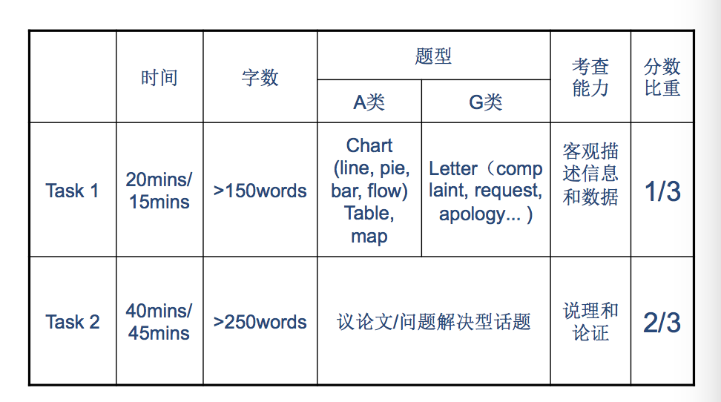
雅思大小作文题型对比

Slide 3
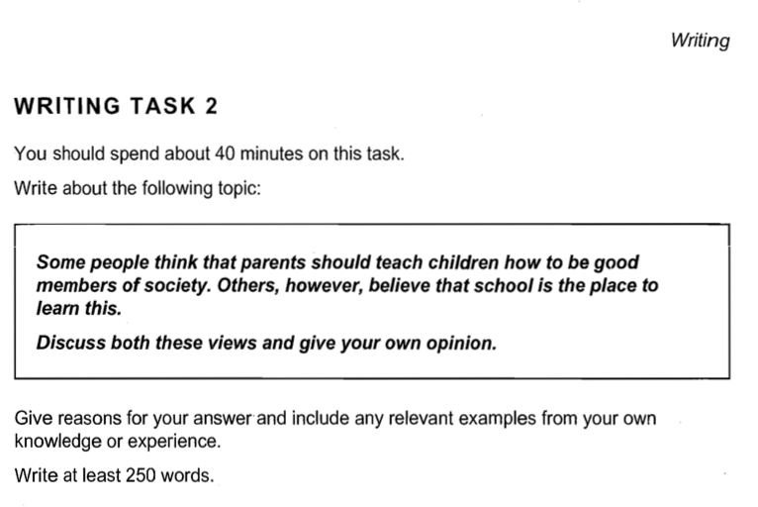
大作文
时间要求
题目话题
内容要求
题目要求
内容要求
字数要求

Slide 4

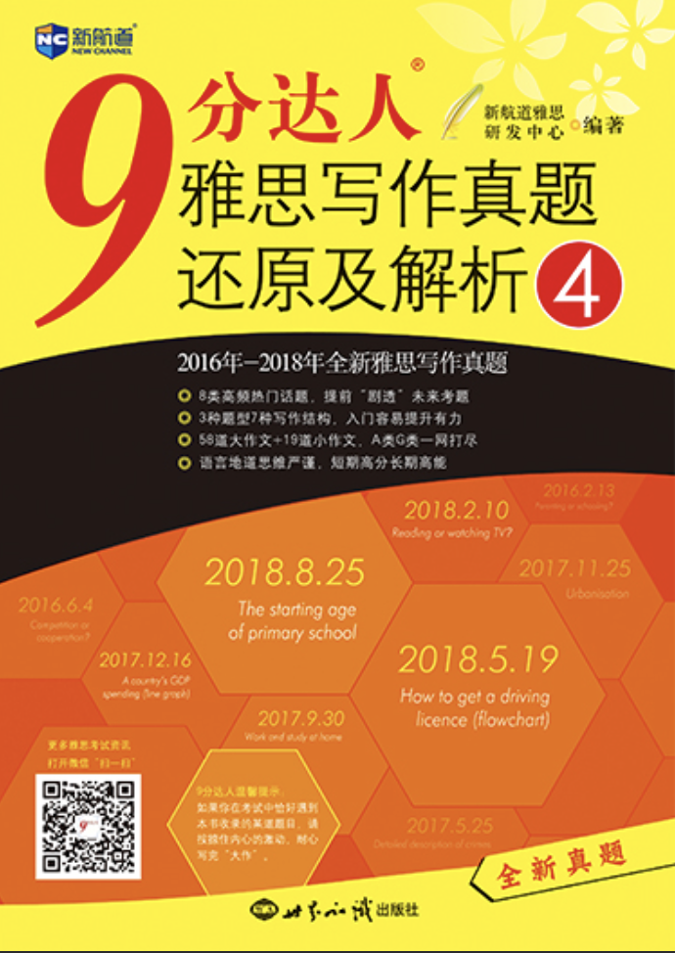
社会类
政府类
教育类
媒体广告类
犯罪类
Task 2
话题分布
环境类
科技类
文化类
全球化

Slide 5
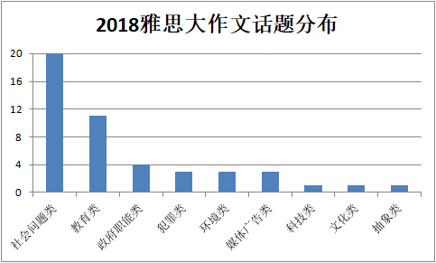
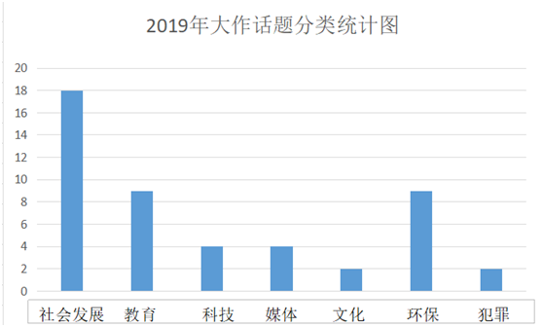
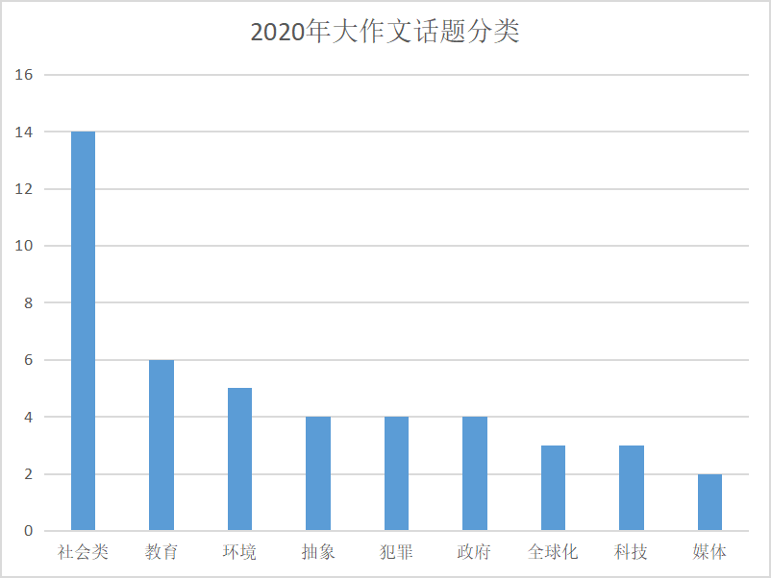
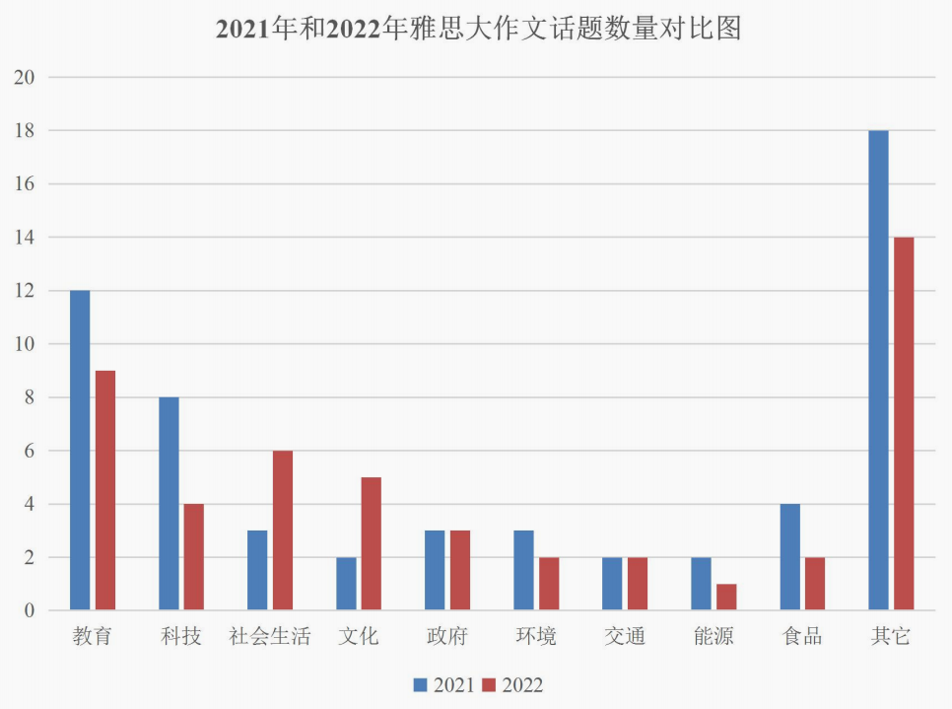

Slide 6
报告型
Task2
命题模式
综合型
双方论述型
同不同意型
权衡利弊型

Slide 7
Task2 命题模式分类
双方讨论型
观点论证型
Argumentation
权衡利弊型
同不同意型
报告型
Report
综合型
Combination

Slide 8
双方讨论型
It is generally believed that some people are born with certain talents, for instance for sport or music,
and others are not. However, it is sometimes claimed that any child can be taught to become a goodsports person or musician. （C7T1）
Discuss both views and give your opinion.
讨论题目中的两种观点，并给出自己的观点

Slide 9
权衡利弊型
In many countries around the world, rural people are moving to cities, so the population in the countryside is decreasing. （C18T3）
Do you think this is a positive or a negative development?
结合给出观点判断利大于弊还是弊大于利

Slide 10
同不同意型
It is important for children to learn the difference between right and wrong at an early age. Punishment is necessary to help them learn this distinction. （C10T1）
To what extent do you agree or disagree with this opinion?
题中给出一个观点，回答是否同意该观点(多大程度上)

Slide 11
报告型
In many countries schools have severe problems with student behaviours. （C4T4）
What do you think are the causes of this? What solutions can you suggest?
对题目所提出的事件或现象分析
形成原因 (causes/ reasons/ factors)
造成影响/ 引发问题/ 导致结果
(influence, effects/ problems/ results, consequences)
解决方案 (solutions, actions, measures)

Slide 12
综合型
Increasing the price of petrol is the best way to solve growing traffic and pollution problems.（C8T3）
To what extent do you agree or disagree?
What other measures do you think might be effective?
报告类和观点论述类混合题型，一般包含两个问题，注意审题，把握两个问题之间的关系。

Slide 13
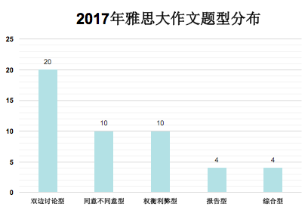
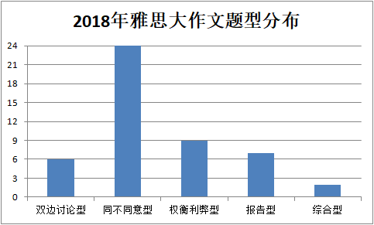
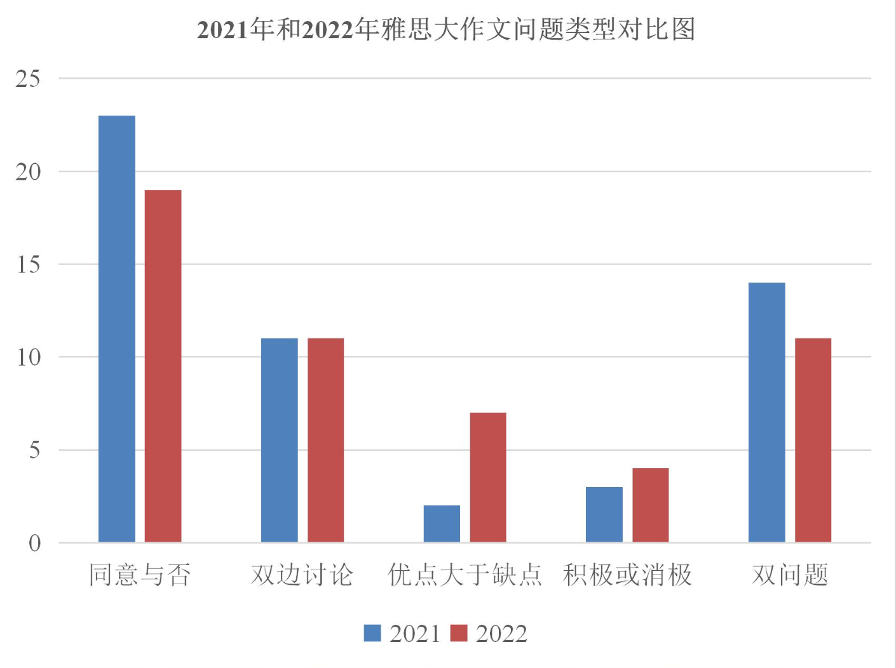
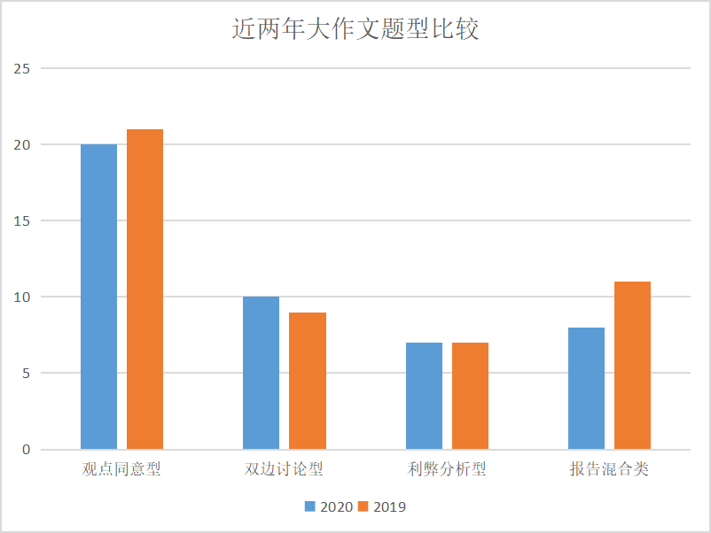

Slide 14
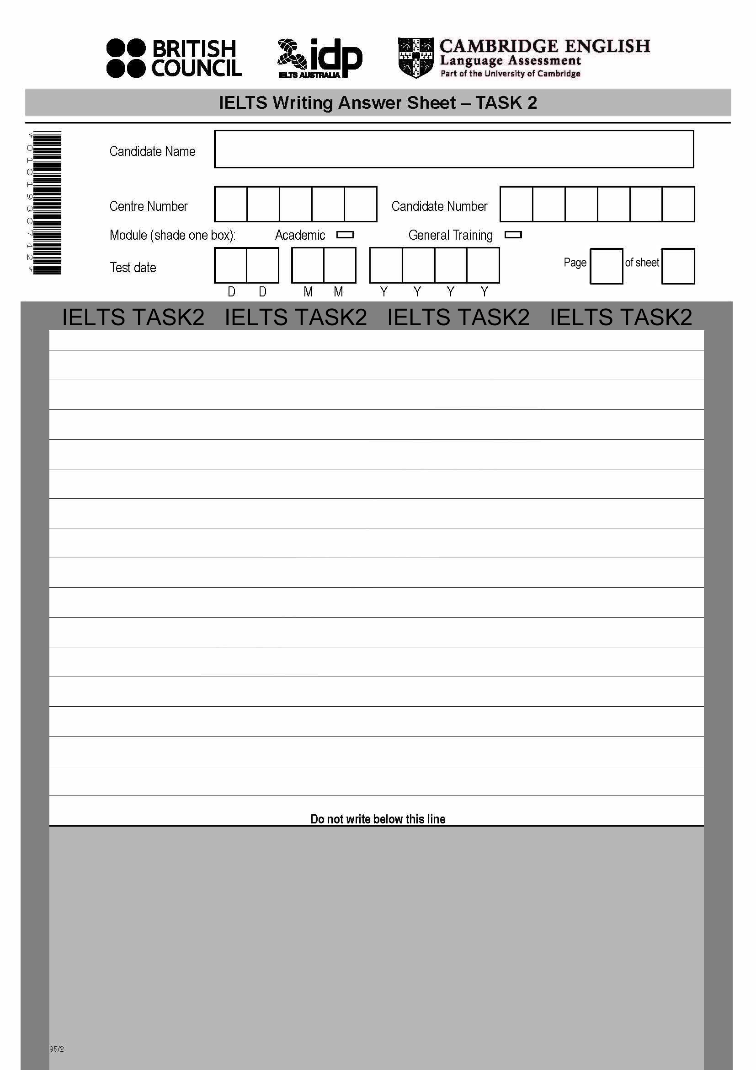
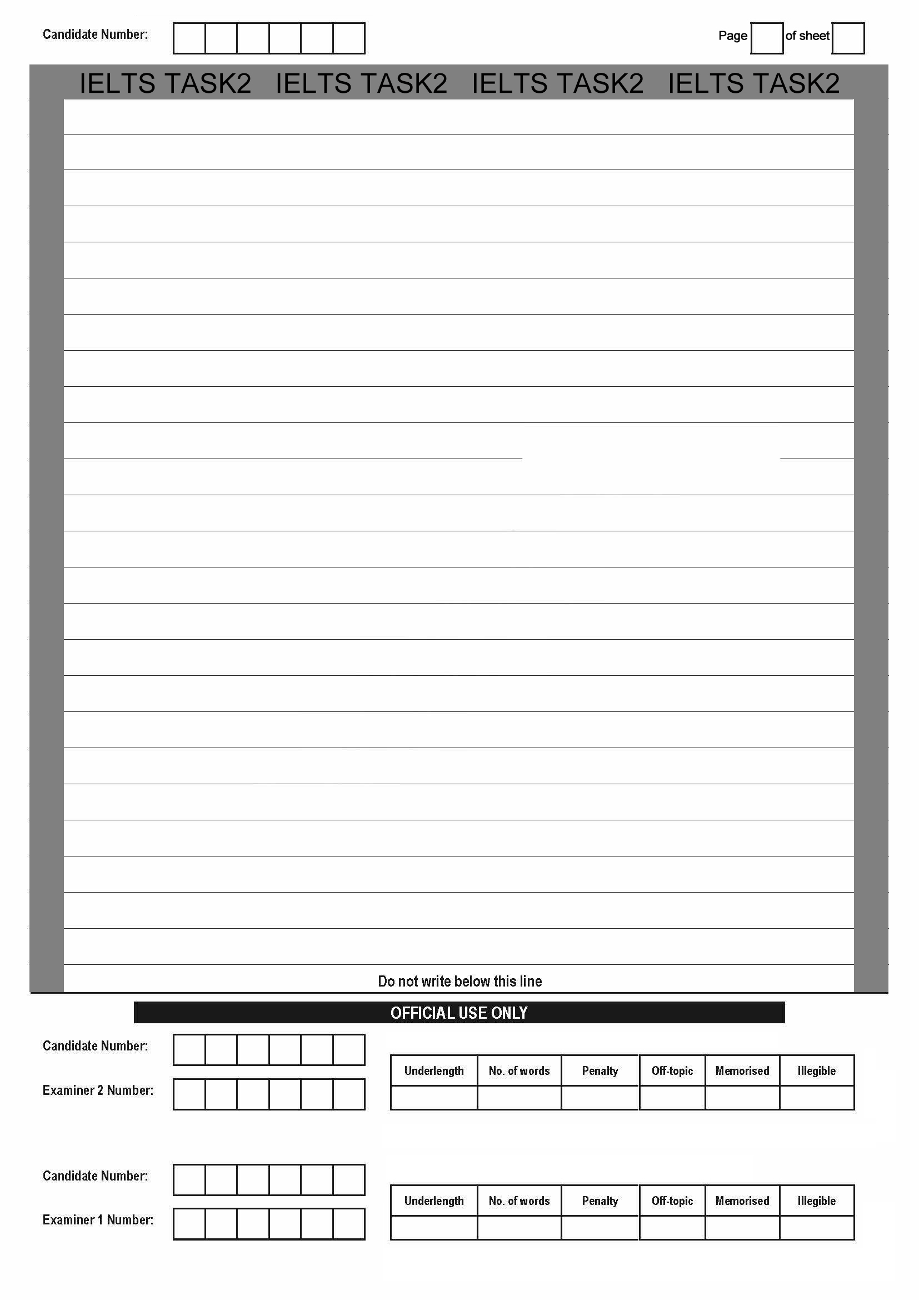
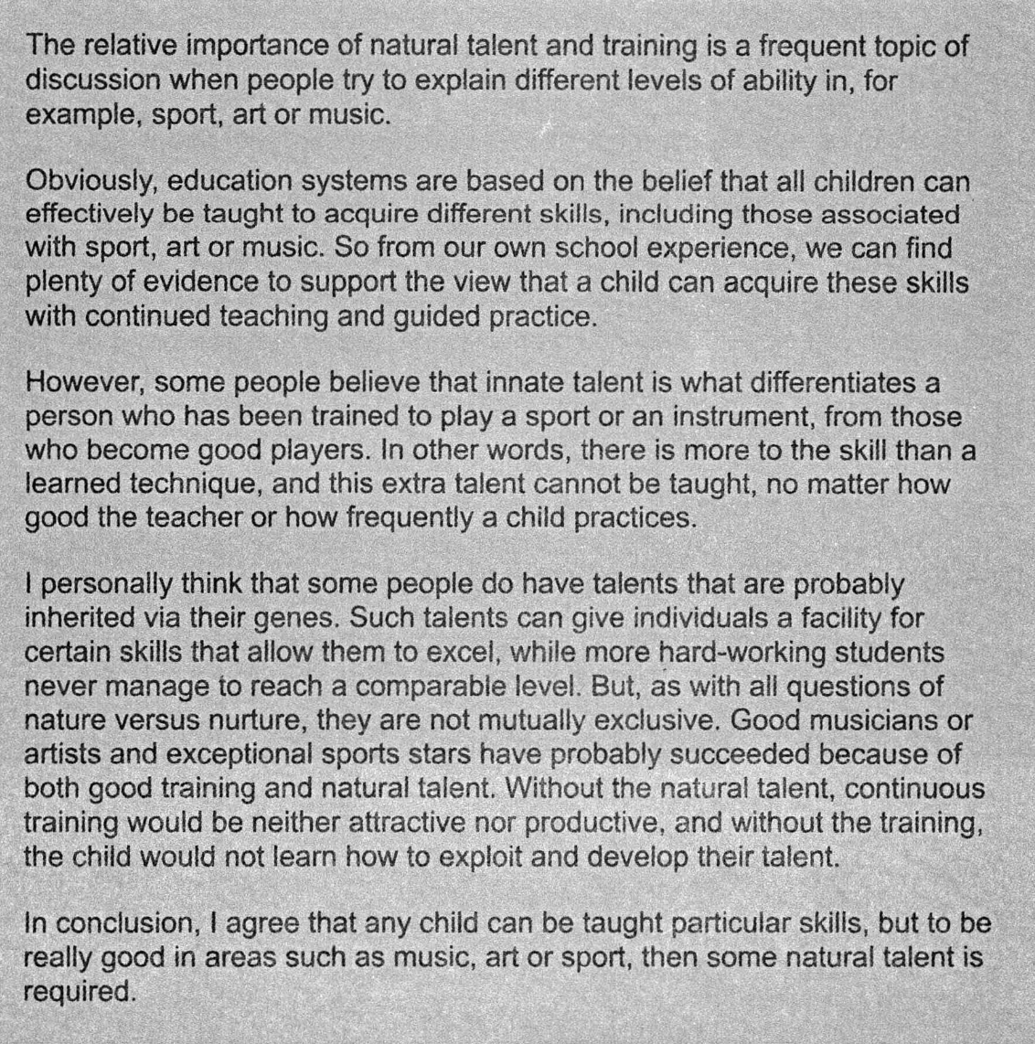
Task 2 Answer Sheet
写作格式要求：
齐头书写
段间空行
字迹清楚
避免缩写

Slide 15
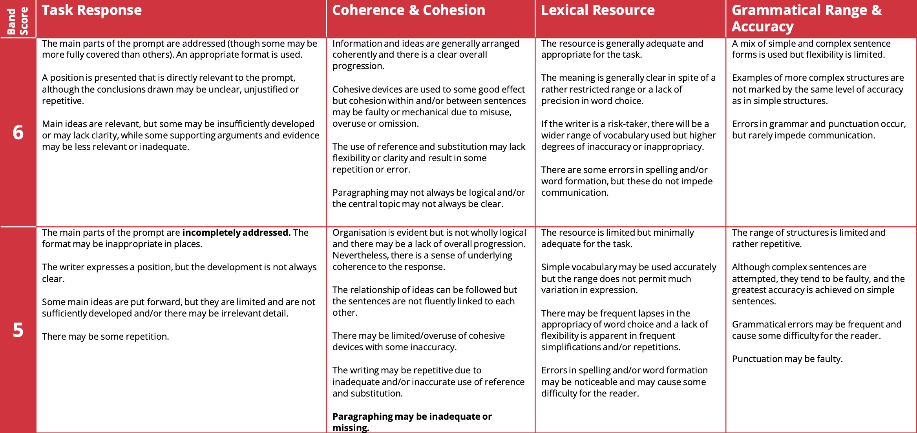
Task 2 评分标准
TR (写作任务回应)
CC (连贯和衔接)
LR (词汇丰富度 )
GRA (语法多样性及准确性 )

Slide 16
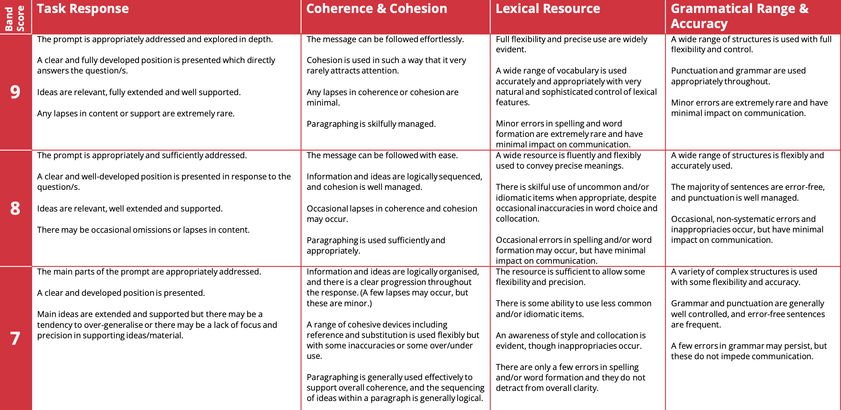

Slide 17
TR：Task Response
(写作任务回应)
回答题中所有问题并且切题
有明确的总论点和分论点
进行有效的论证
Tip: 字数要求> 250 字 建议：280-300字
审题全面并且准确
构思清晰并且有逻辑

Slide 18
审题5要点
审题要点1: 问题是什么
【例】 Nowadays, older people who need employment have to compete with younger people. What problems do this cause? And what are the solutions? (2015-04-11)
Cause: v. 引起，会引发哪些问题
【例】In some countries the average weight of people is increasing and their levels of health and fitness are decreasing. What do you think are the causes of these problems and what measures could be taken to solve them? (2017-12-09)
Cause: n. 原因，造成这些问题的原因有哪些

Slide 19
练习 判断以下思路有没有完整回应题目
Some people think that all university students should study whatever they like. Others believe that they should only be allowed to study subjects that will be useful in the future, such as those related to science and technology.
Discuss both these views and give your own opinion.
兴趣能激发人的学习热情，但学对未来有用的技能比较好就业
不完整：双边讨论的题型没有先对两边的看法作讨论

Slide 20
审题要点2: 转折连词
【例】Food can be produced more cheaply today because of improved fertilizers and better machinery. However, some people think that the methods used to achieve this may have negative effects on human health and local communities. To what extent do you agree or disagree？ (2012-5-19)
判断however前是客观事实还是观点：
客观事实无需分析讨论,客观事实通常以陈述句形式呈现
观点需要分析讨论,观点句式：
it is important/necessary.../it is believed that...

Slide 21
审题要点3: 因果连词
【例】Schooling is no longer necessary, since more and more information is accessible on the internet, and students can study just as well at home. To what extent do you agree or disagree? (2017-3-25)
判断个人观点（是否同意结论句）：
同意，那么since之后的内容可作为论点
不同意，那么可以先反驳since之后的内容，再根据个人观点展开论点

Slide 22
审题要点4: 并列结构
【例】 Children spend long time studying in school. What are the positive or negative effects on children and society they live in? (2013-01-12)
判断并列关系出现的位置：
在话题句出现，拓展思路必须针对这几个方面
在问题中出现，可以根据并列内容分段讨论

Slide 23
练习 判断以下思路有没有完整回应题目
Some people believe that work is the most important thing in a person's life and that without career success life will become meaningless.
To what extent do you agree or disagree?
不同意：工作很重要，但是还有很多别的事情也很重要。
不完整：没有回应并列关系的后半部分 ‘without career success life will become meaningless.’

Slide 24
【例】Some people think that the increasing use of computers and mobile phones for communication has had a negative effect on young people’s reading and writing skills. Do you agree or disagree? (2015-03-28)
讨论内容必须是限定内容，否则偏题
审题要点5: 范围限定

Slide 25
练习 判断以下思路有没有完整回应题目
Some school leavers travel or work for a period of time instead of going directly to university.
What are the advantages and disadvantages for their studies?
利：能够开阔视野，提前积累工作经验，提升未来竞争力。
弊：可能会觉得大学里教的东西太理论化，与自己的真实体验不符合，进而产生抵触心理。
不完整：利的部分中没有和‘for their studies’有直接联系。

Slide 26
审题总结
审题要点1:问题是什么
审题要点2: 转折连词
审题要点3: 因果连词
审题要点4: 并列结构
审题要点5: 范围限定

Slide 27
CC：Coherence & Cohesion
(连贯和衔接)
Merriam-Webster’s Advanced Learner’s English-Chinese Dictionary的定义：
Coherence：ideas are logical and well-organized: easy to understand
Cohesive: ideas are closely united

Slide 28
CC：Coherence & Cohesion
(连贯和衔接)
内容连贯、逻辑清晰
有效使用衔接手段和指代手段
有效地进行分段
使用上下义词进行替换
Tip:逻辑连接词不意味着文章有逻辑，但是要先学会正确使用它们；
文章逻辑性很大程度取决于句子内部的联系

Slide 29
CC：Coherence & Cohesion
(连贯和衔接)
Decreasing birth rates can be attributed to two main factors, namely: availability of family planning and changes in how people feel about work and family. These changes include greater career aspirations among women, a tendency to delay marriage, and a preference for smaller families. Lower mortality, on the other hand, is due to increased longevity, which results from improved health care and better living conditions.
“也就是”
并列连词
指代
转折关系
关系代词

Slide 30
逻辑连接词
1. 因果关系
1）because/since/as/for/ considering that/ given that ...（从句）, ....（主句）
2）because of /owing to/ due to/ in view of sth，...
1) for such reasons/ as a result / therefore/ consequently/ thus / hence/in consequence/ as a consequence/under these conditions,...
2) …, so/ so that....
2.转折关系
1) ..., but/while…
2) though/ even though / despite that/ in spite of the fact that..., ....
3) however/ nevertheless/ on the other hand, ...
3. 并列关系
1) ... and/ as well as ...
2) both...and... either...or...

Slide 31
逻辑连接词
4. 递进关系
1) Furthermore/ moreover/ in addition (to sth) / additionally / besides/ meanwhile/ at the same time, ...
2) not only...but also.../ for one thing... for another/
more specifically/ in other words,...
5. 先后关系
first/ to begin with/ to start with/ first of all,...
second/ next/ afterwards/ since then/ prior to this,....
at last/ eventually/ last but not least/ to end with/ finally,...
6.举例关系
for example/ for instance, ...
a case in point is.../ a good example would be...
...., namely/ such as/ including sth

Slide 32
逻辑连接词
7.比较关系
in comparison with/ when compared with/ compared with sth,...
similarly/ likewise,....
Like/unlike sth, ....
8.强调关系
in fact/ undoubtedly/ without a doubt/ undeniably/ obviously , ...
especially/ particularly sth,...

Slide 33
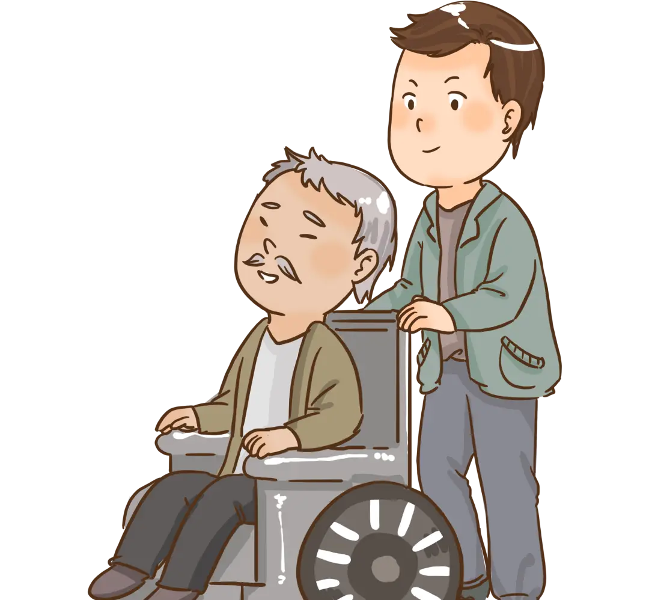
LR：Lexical resource(词汇丰富度 )
How to improve your vocabulary?
synonyms 同义词替换
offsprings
younger relatives
senior citizens
older relatives
those of retirement age

Slide 34
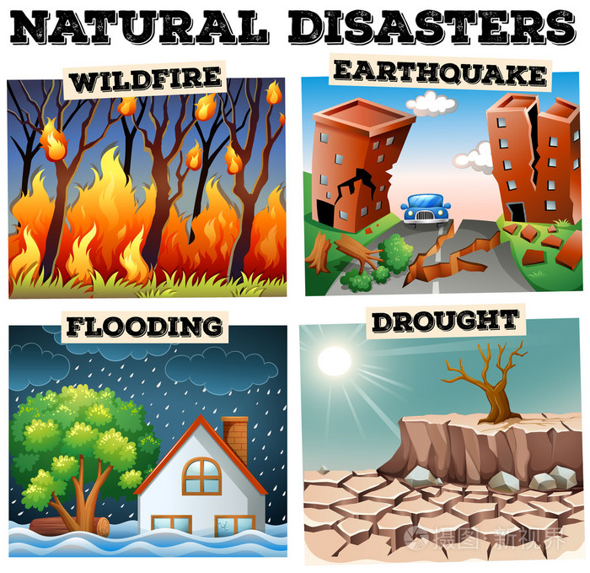
LR：Lexical resource(词汇丰富度 )
How to improve your vocabulary?
superordinate/subordinate 上下义词

Slide 35
LR：Lexical resource(词汇丰富度 )
How to improve your vocabulary?
word combination/ collocation 词组
broaden one’s horizon 拓宽视野
rote learning 死记硬背
word formation 构词法
compounding复合词-- fingerprint 指纹
derivation派生词-- fluctuate/fluctuation

Slide 36
GRA：Grammatical Range & Accuracy
(语法多样性及准确性 )
语法使用原则
1. 句式多样（简单， 并列，复合）
2. 句子语法正确
3. 准确地使用标点符号

Slide 37
1. 复杂的语法结构
例：They tend to be more independent. It is a very important factor in academic study and research. It will also give them an advantage in terms of coping with the challenges of student life.
改：They tend to be more independent, which is a very important factor in academic study and research, as well as giving them an advantage in terms of coping with the challenges of student life.

Slide 38
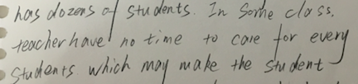
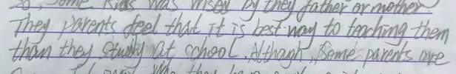
2. 对语法掌握程度
单复数
单复数
主谓一致
最高级
指代错误
to加动词原形

Slide 39
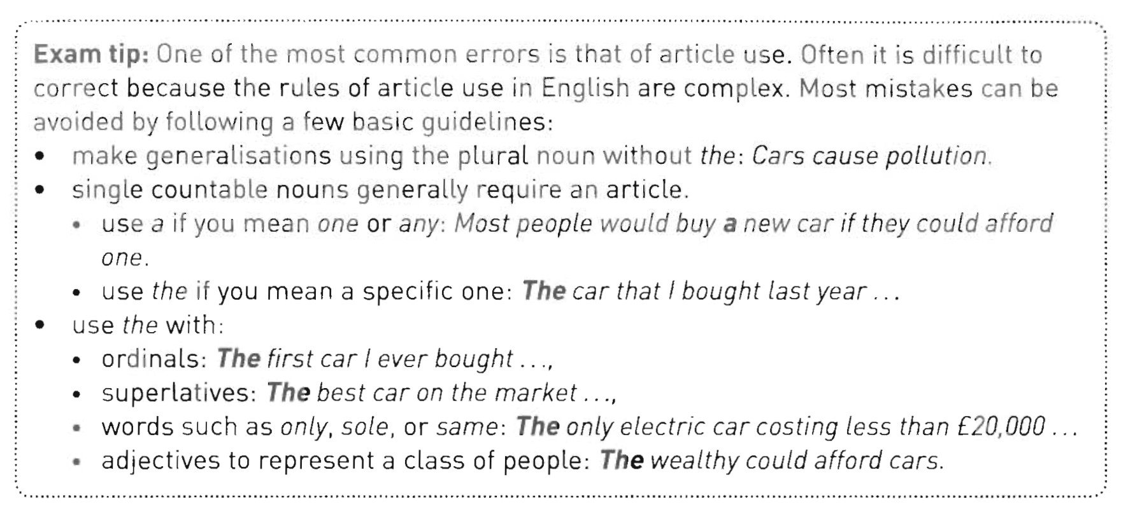
冠词的使用
用复数名词表示概括时不需要加定冠词the
单数可数名词前需要加不定冠词a/an
序数词，最高级，only等词和形容词表示一类人时，前面需要加the

Slide 40
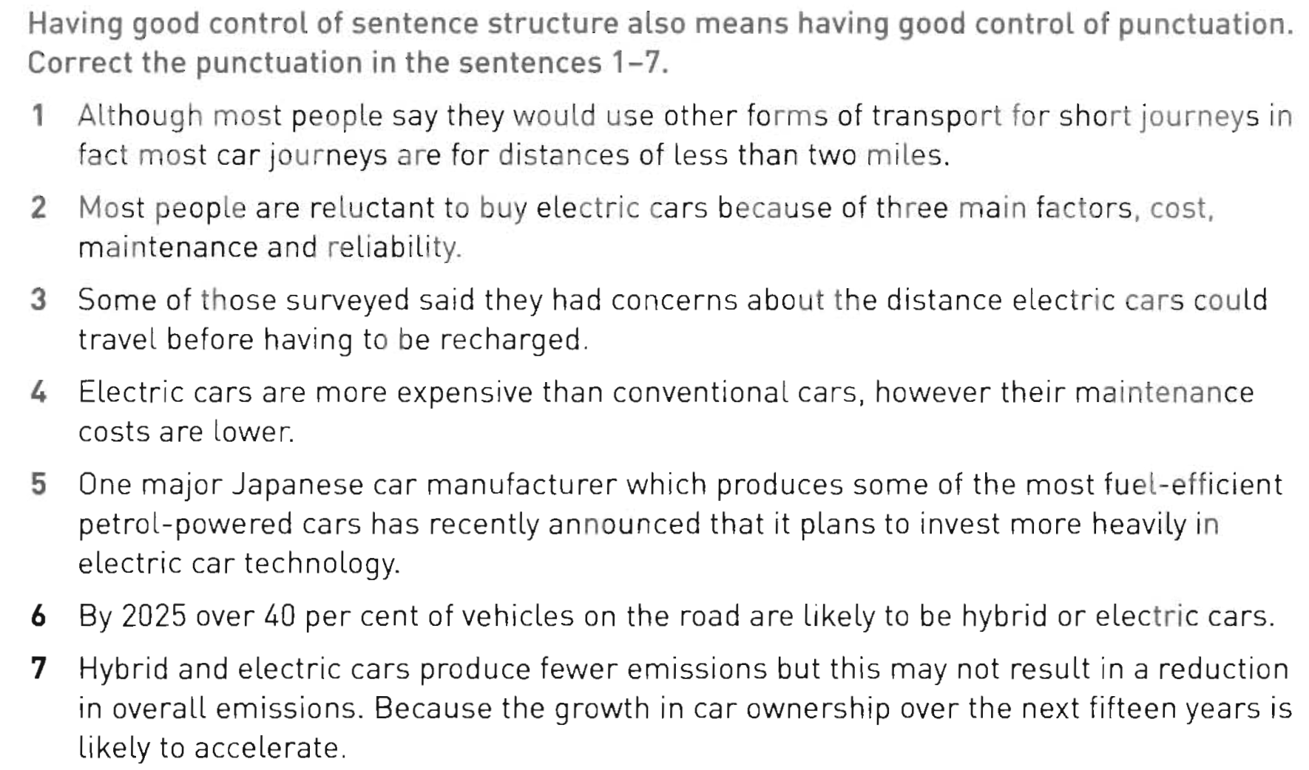
3. 对标点符号掌握程度
,
,
:
.H ,
,
,
,
,
emissions because

Slide 41
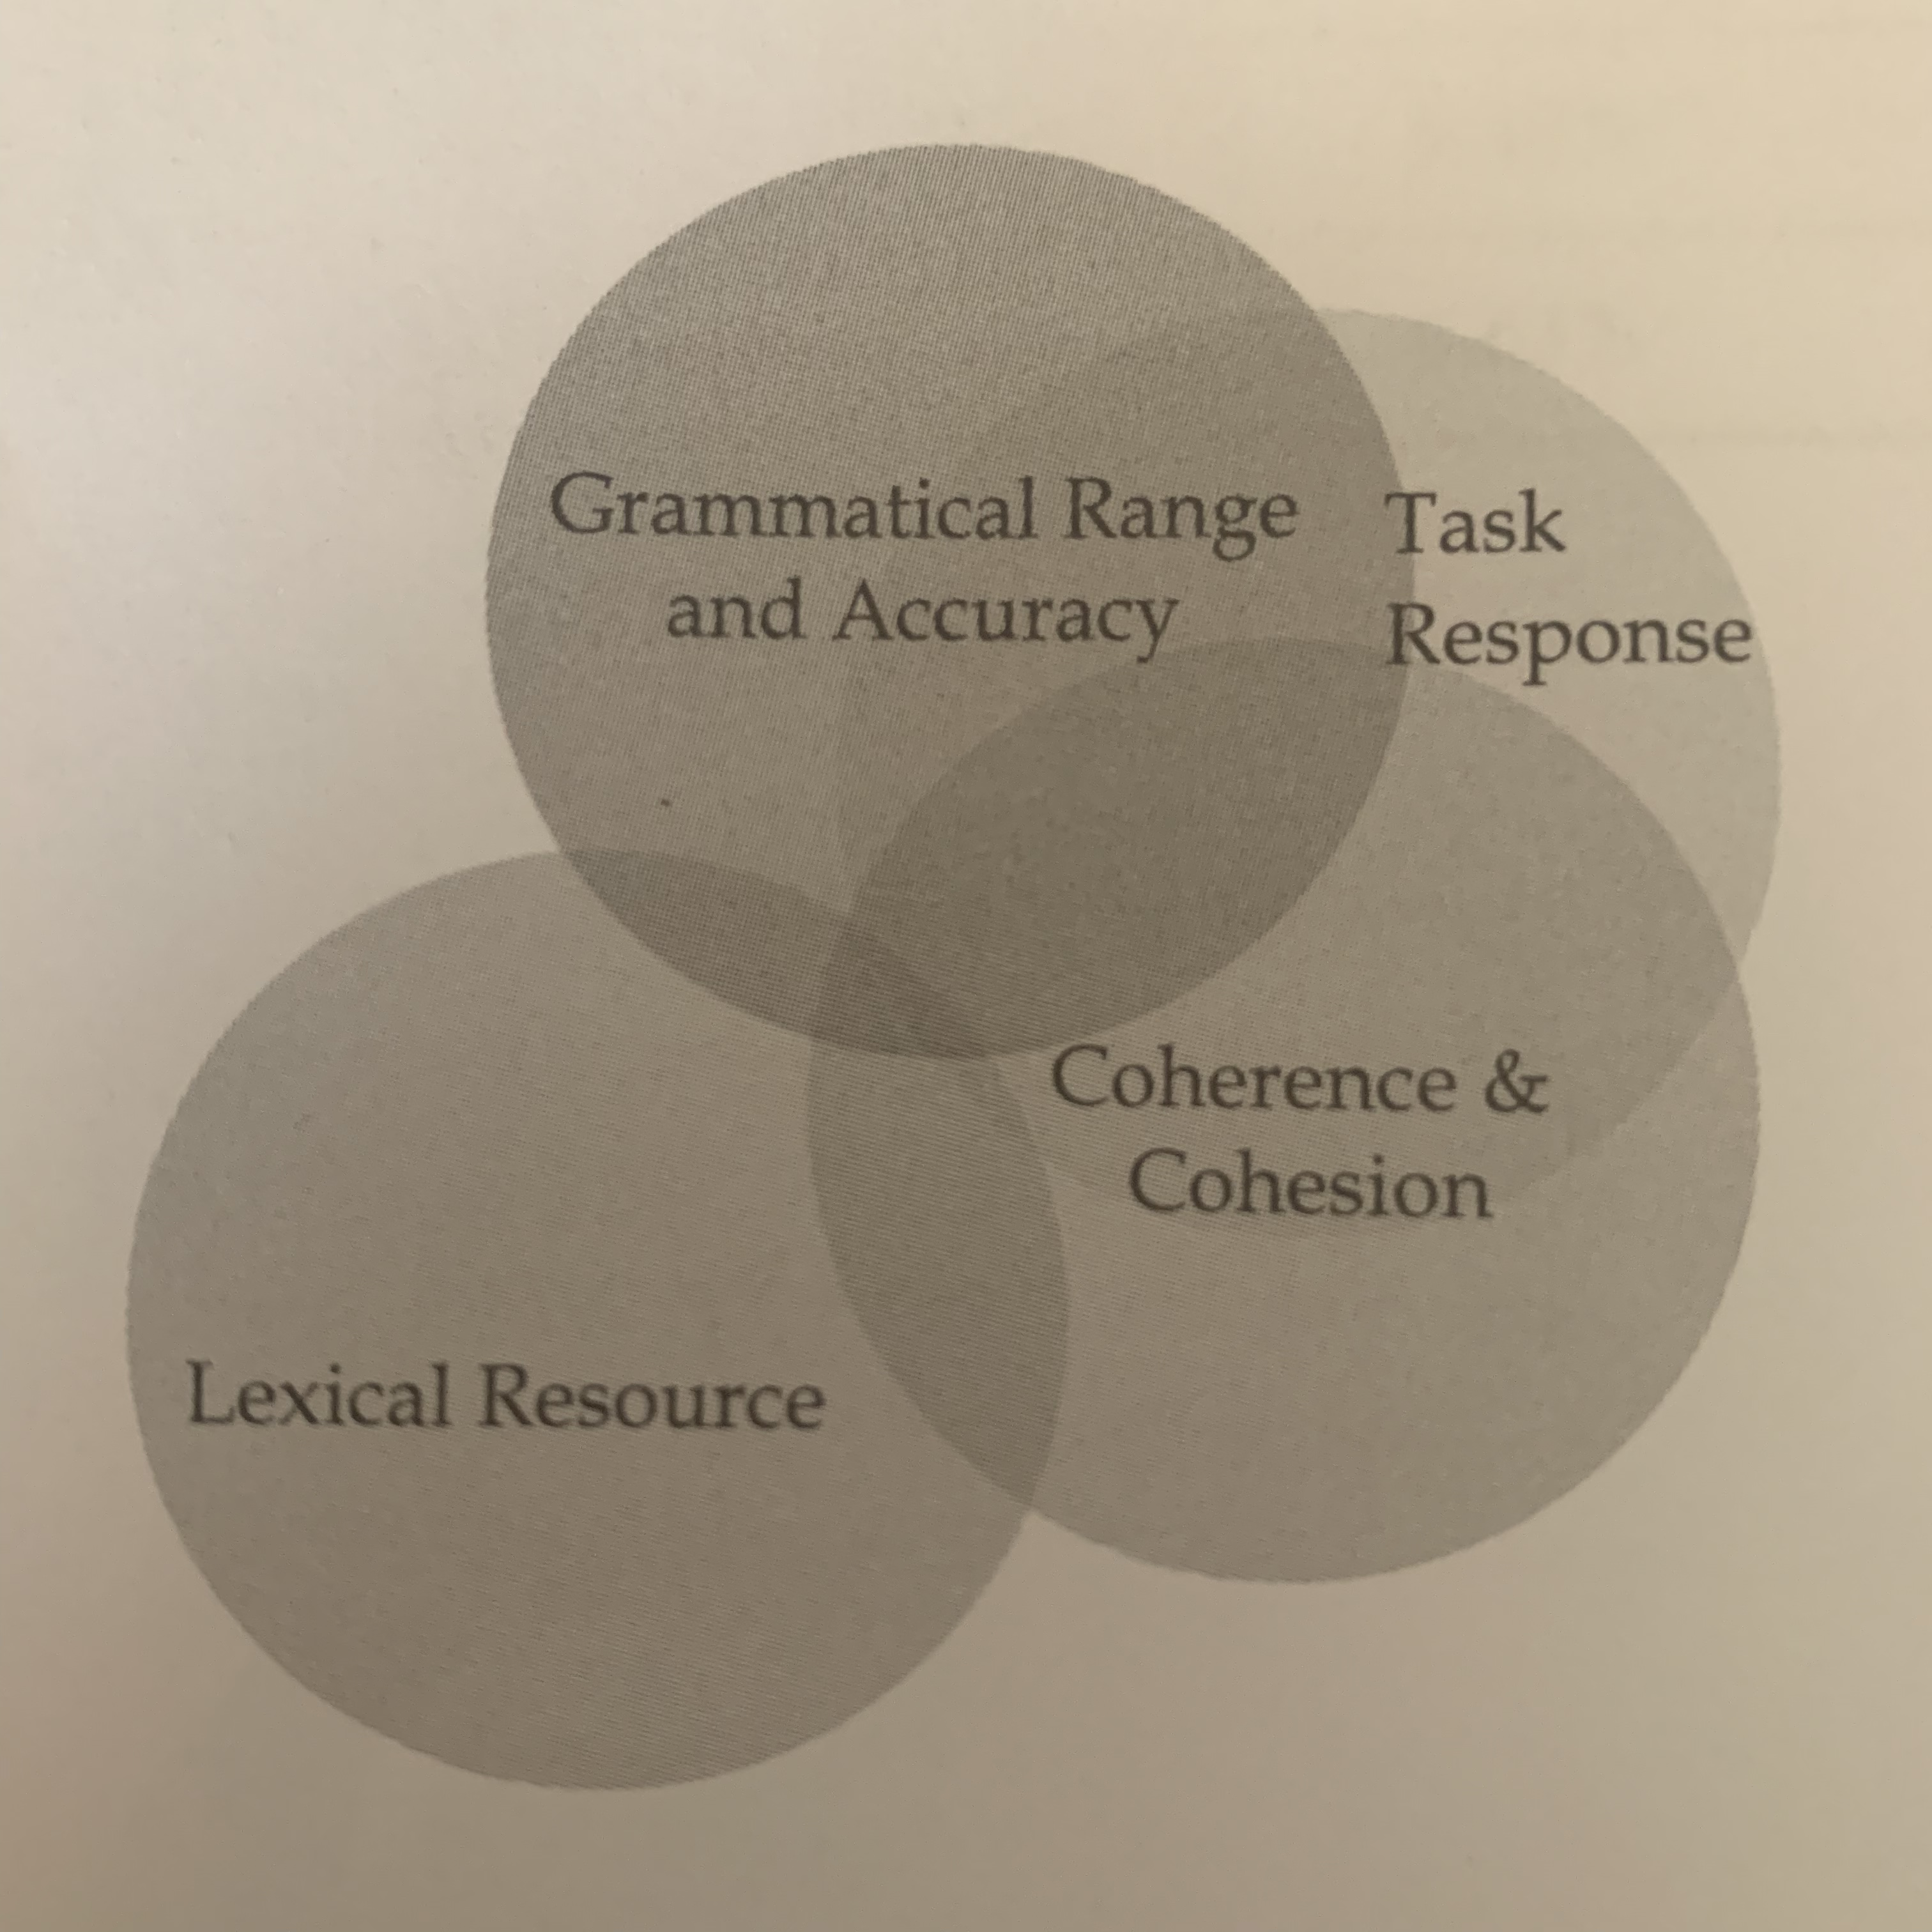
Task 2 评分标准
TR (Task Response 写作任务回应)
最重要，不能跑题或者偏题
CC (Coherence & Cohesion 连贯和衔接)
观点连贯有逻辑性。全文总观点、分论点和段落中句子之间的关系
GR&A (Grammatical Range& Accuracy)
句式结构多样 & 语法准确度
LR (Lexical Resources 词汇丰富度)
准确 & 多样

Slide 42
Review
1. Task2 常见话题分布
教育，科技，社会问题，环境资源，广告媒体，文化艺术，政府职能，犯罪，全球化
2. Task2 命题模式
报告型，观点论证型（双方讨论型、权衡利弊型、同不同意型），综合型
3. Task2 评分标准
TR (Task Response 写作任务回应)
CC (Coherence & Cohesion 连贯和衔接)
LR (Lexical Resources 词汇丰富度)
GR&A (Grammatical Range& Accuracy 语法多样性及准确性 )
4. Task2 审题要点

Slide 43
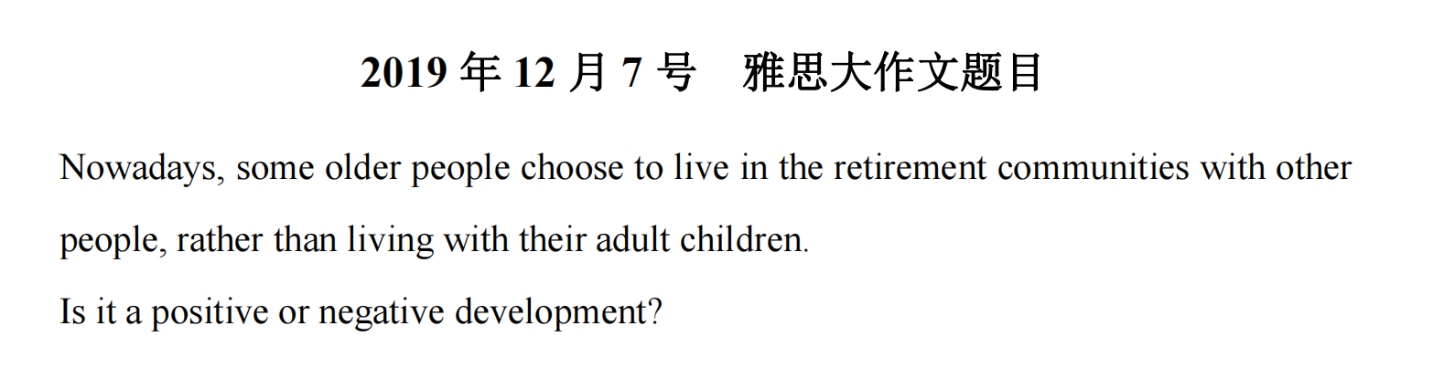
Homework: finish one body paragraph

